Slide 1
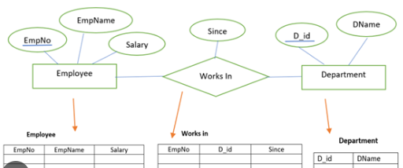
ER Diagram into Relation Model
By
Dr.S.P. Siddique Ibrahim
VIT-AP University
Amaravati

Slide 2
Conversion of E-R Diagram into Relational Model
ER diagram is converted into the tables in relational model.
This is because relational models can be easily implemented by RDBMS like MySQL , Oracle etc

Slide 3
Conversion of E-R Diagram into Relational Model
In general conversion of E-R diagram into a relational model involves the following:
Mapping of an entity set into relation (tables) of the database.
The attributes of a table include the attributes of an entity
The key attribute of an entity becomes the primary key of the relation

Slide 4
Rule-01: For Strong Entity Set With Only Simple Attributes-
A strong entity set with only simple attributes will require only one table in relational model.
Attributes of the table will be the attributes of the entity set.
The primary key of the table will be the key attribute of the entity set.

Slide 5
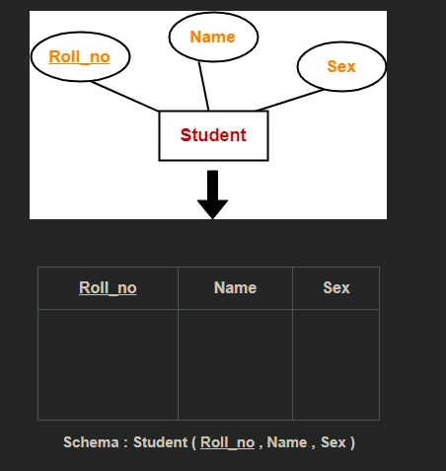
Example

Slide 6
Rule-02: For Strong Entity Set With Composite Attributes-
A strong entity set with any number of composite attributes will require only one table in relational model.
While conversion, simple attributes of the composite attributes are taken into account and not the composite attribute itself.

Slide 7
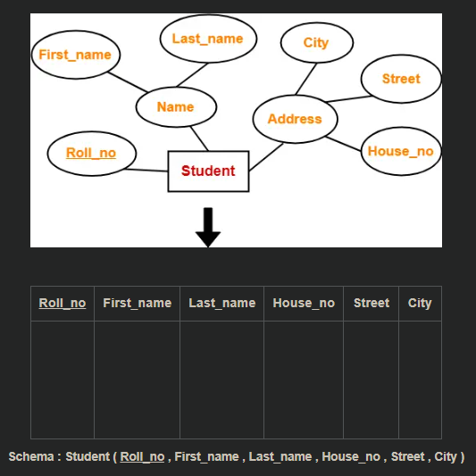
Example

Slide 8
Rule-03: For Strong Entity Set With Multi Valued Attributes-
A strong entity set with any number of multi valued attributes will require two tables in relational model.
One table will contain all the simple attributes with the primary key.
Other table will contain the primary key and all the multi valued attributes.-Foreign Key

Slide 9
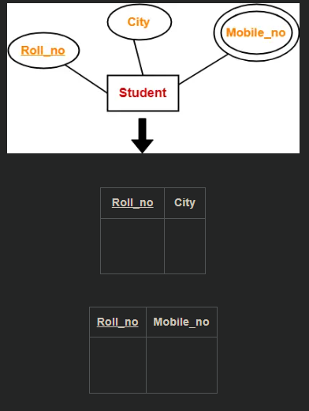
Example

Slide 10
Rule-04: Translating Relationship Set into a Table-
A relationship set will require one table in the relational model.
Attributes of the table are-
Primary key attributes of the participating entity sets
Its own descriptive attributes if any.
Set of non-descriptive attributes will be the primary key.

Slide 11
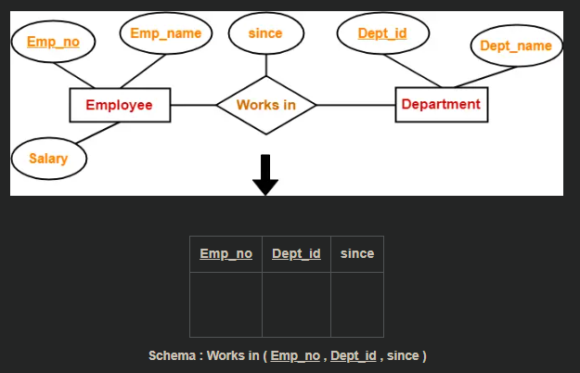
Example

Slide 12
If we consider the overall ER diagram, three tables will be required in relational model-
One table for the entity set “Employee”
One table for the entity set “Department”
One table for the relationship set “Works in”

Slide 13
Rule-05: For Binary Relationships With Cardinality Ratios-
The following four cases are possible-
Case-01: Binary relationship with cardinality ratio m:n
Case-02: Binary relationship with cardinality ratio 1:n
Case-03: Binary relationship with cardinality ratio m:1
Case-04: Binary relationship with cardinality ratio 1:1

Slide 14
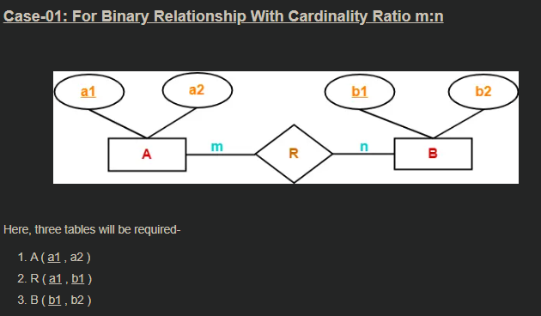
M:M

Slide 15
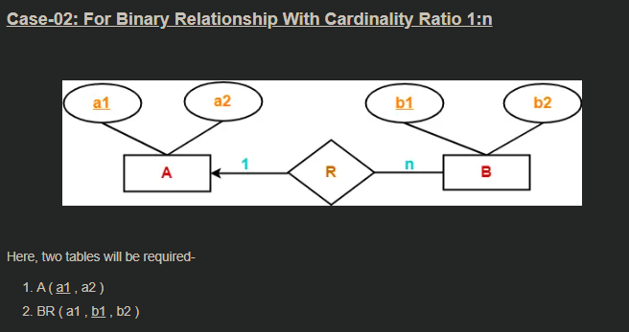
1:M

Slide 16
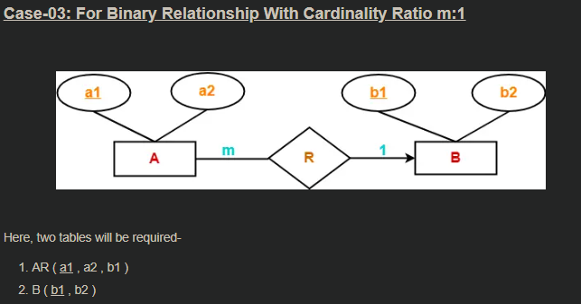
M:1

Slide 17
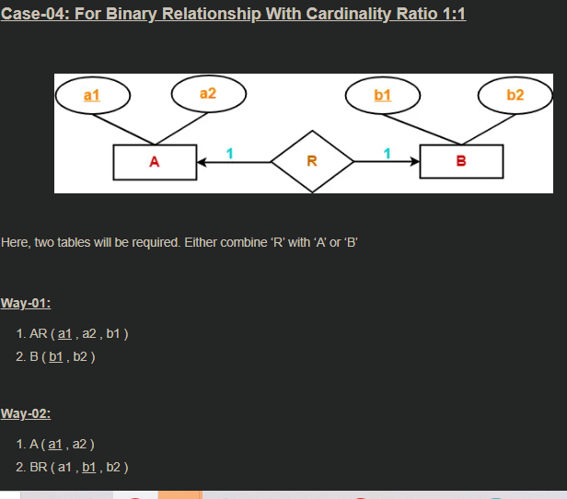
1:1

Slide 18
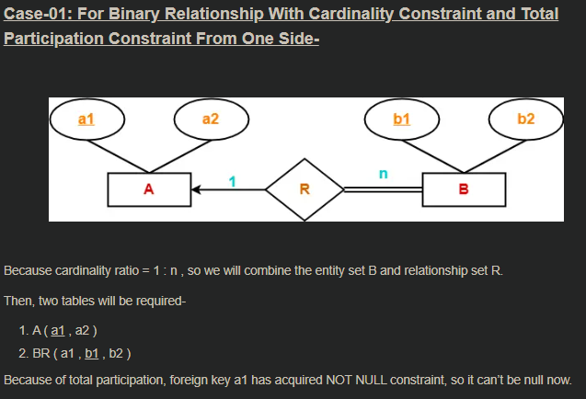
Rule-06: For Binary Relationship With Both Cardinality Constraints and Participation Constraints-

Slide 19
Rule-07: For Binary Relationship With Weak Entity Set-
Weak entity set always appears in association with identifying relationship with total participation constraint.

Slide 20
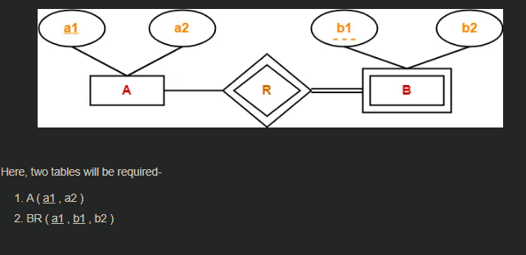
Example

Slide 21
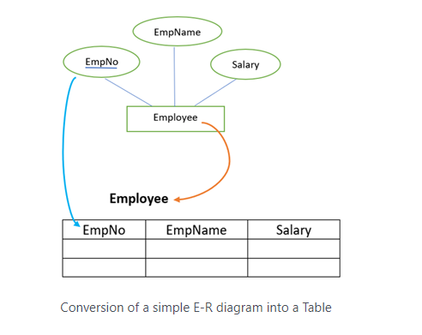

Slide 22
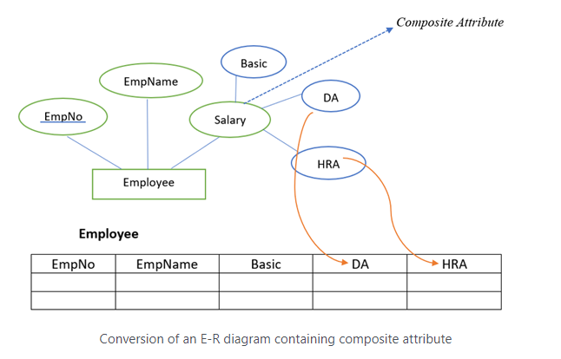
Entity set with a composite attribute

Slide 23
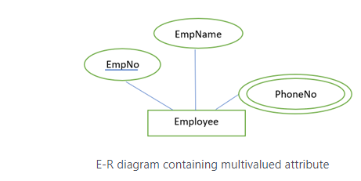
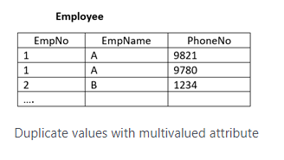
Entity set with multivalued attributes
If we include the PhoneNo in the table with all other attributes, then for a single-valued tuple we may have multiple entries as shown in the table below

Slide 24
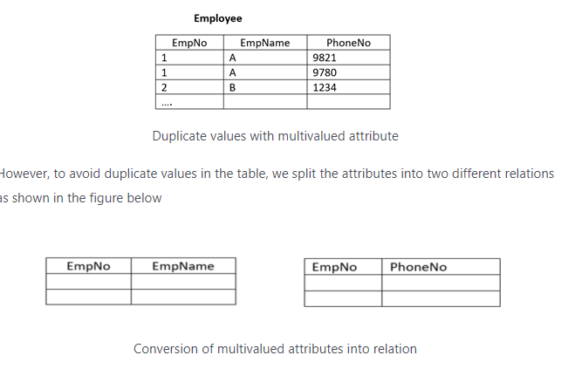

Slide 25
Translation of a relationship into a relation
Likewise, we map the entity set into the relation in a relational model, we can also map a relationship set into a relation.
The attribute of such a relation includes key attributes of the participating relations.
The attributes are will become a foreign key.

Slide 26
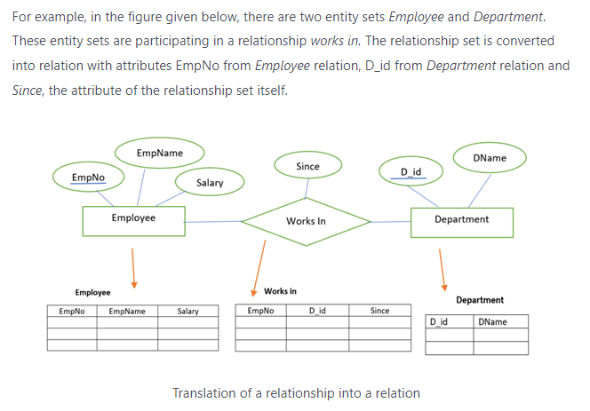

Slide 28
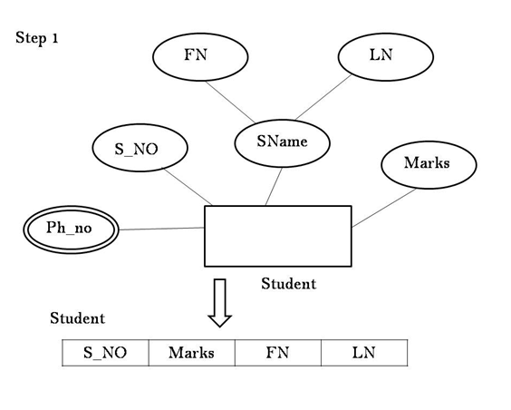

Slide 29
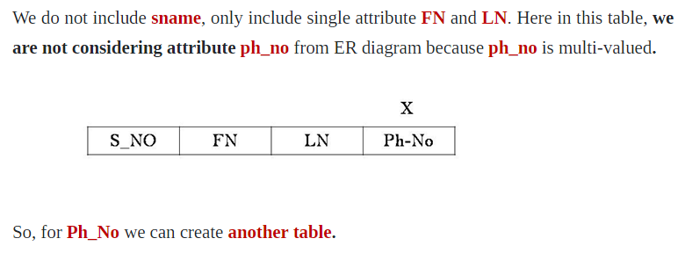

Slide 30
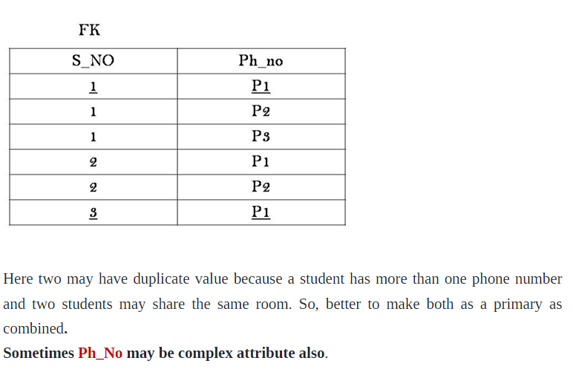

Slide 31
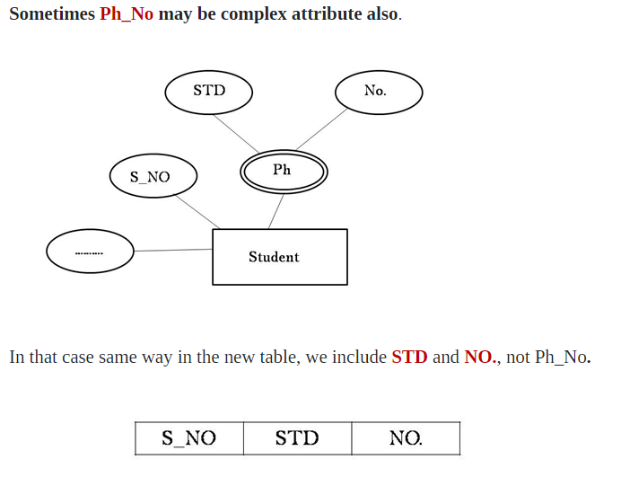

Slide 32
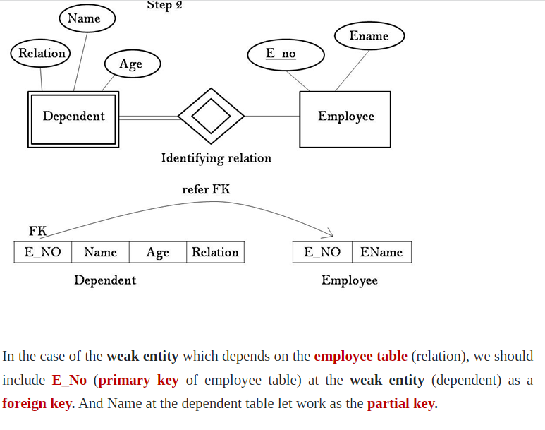

Slide 33
Entity Sets to Database Tables
Each attribute of the entity set becomes an attribute of the table.
Note that we know both the domain of each attribute and the (primary) key of an entity set.

Slide 34
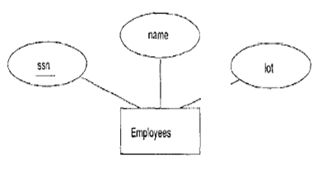
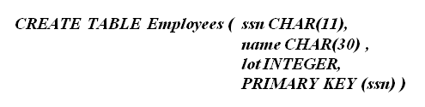
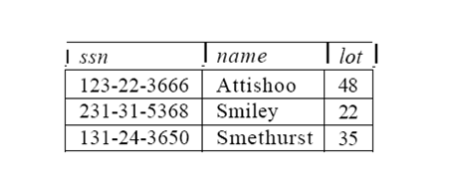
Entity Sets to Database Tables

Slide 35
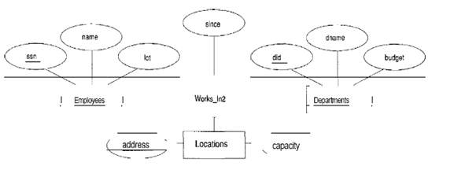
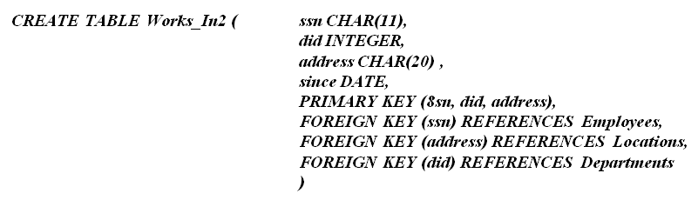
Relationship Sets to Tables

Slide 36
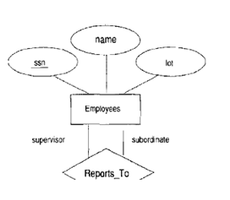
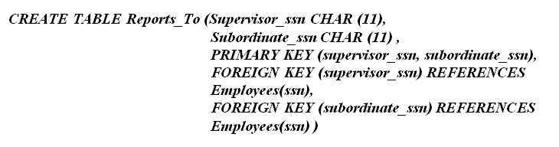
Relationship Sets to Tables

Slide 37
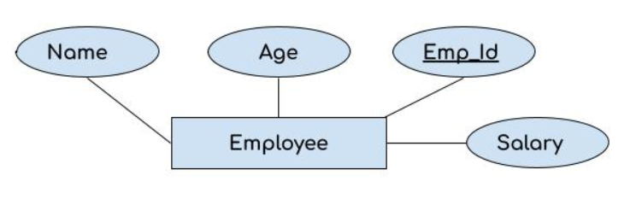
GENERAL EXAMPLS (E-R to DATABASE)

Slide 38
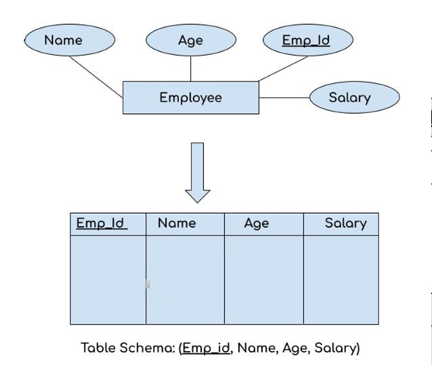
E-R to DATABASE Solution

Slide 39
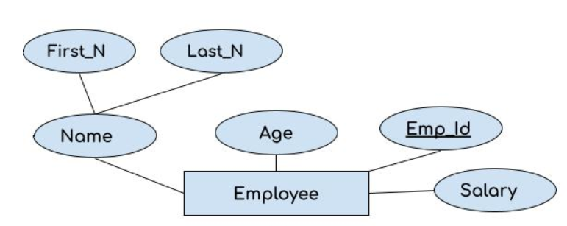
GENERAL EXAMPLS (E-R to DATABASE)

Slide 40
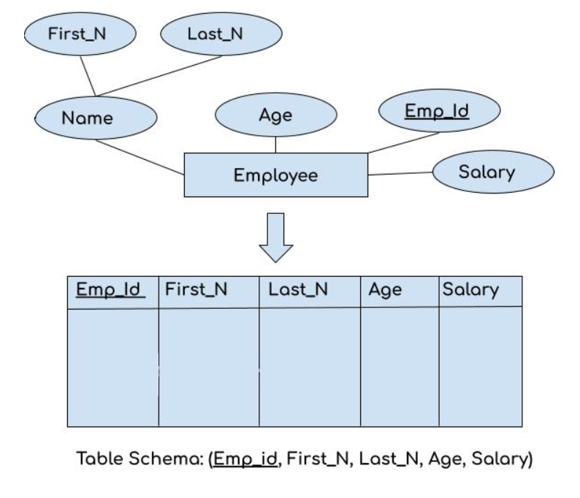
E-R to DATABASE Solution

Slide 41
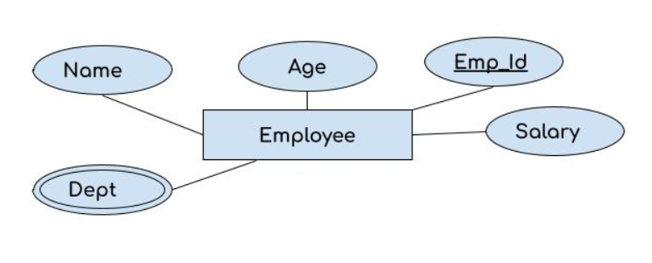
GENERAL EXAMPLS (E-R to DATABASE)

Slide 42
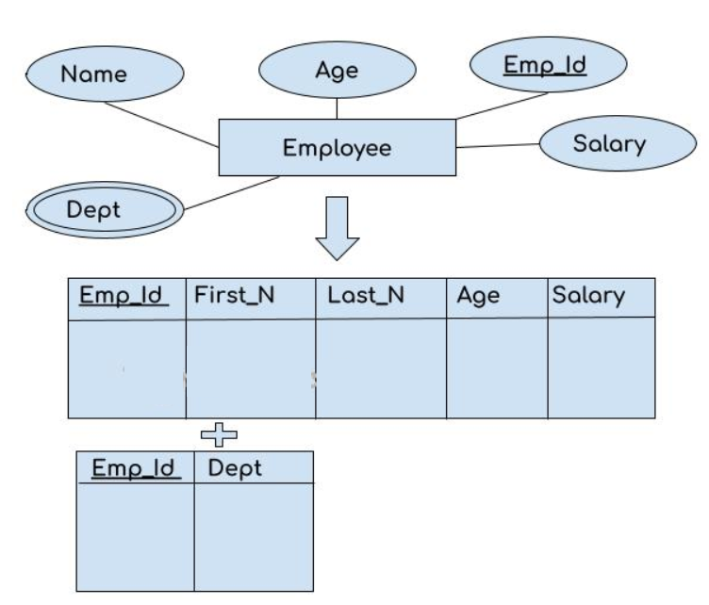
E-R to DATABASE Solution

Slide 43
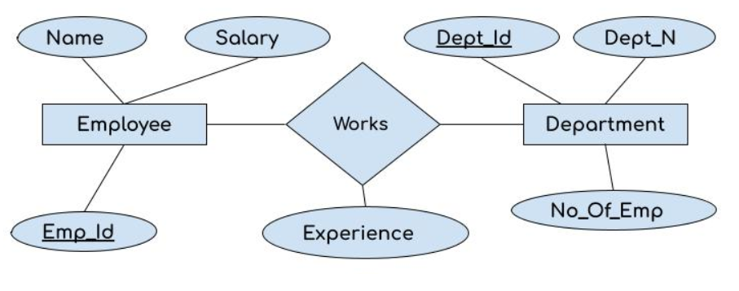
GENERAL EXAMPLS (E-R to DATABASE)

Slide 44
E-R to DATABASE Solution

Slide 45
GENERAL EXAMPLS (E-R to DATABASE)

Slide 46
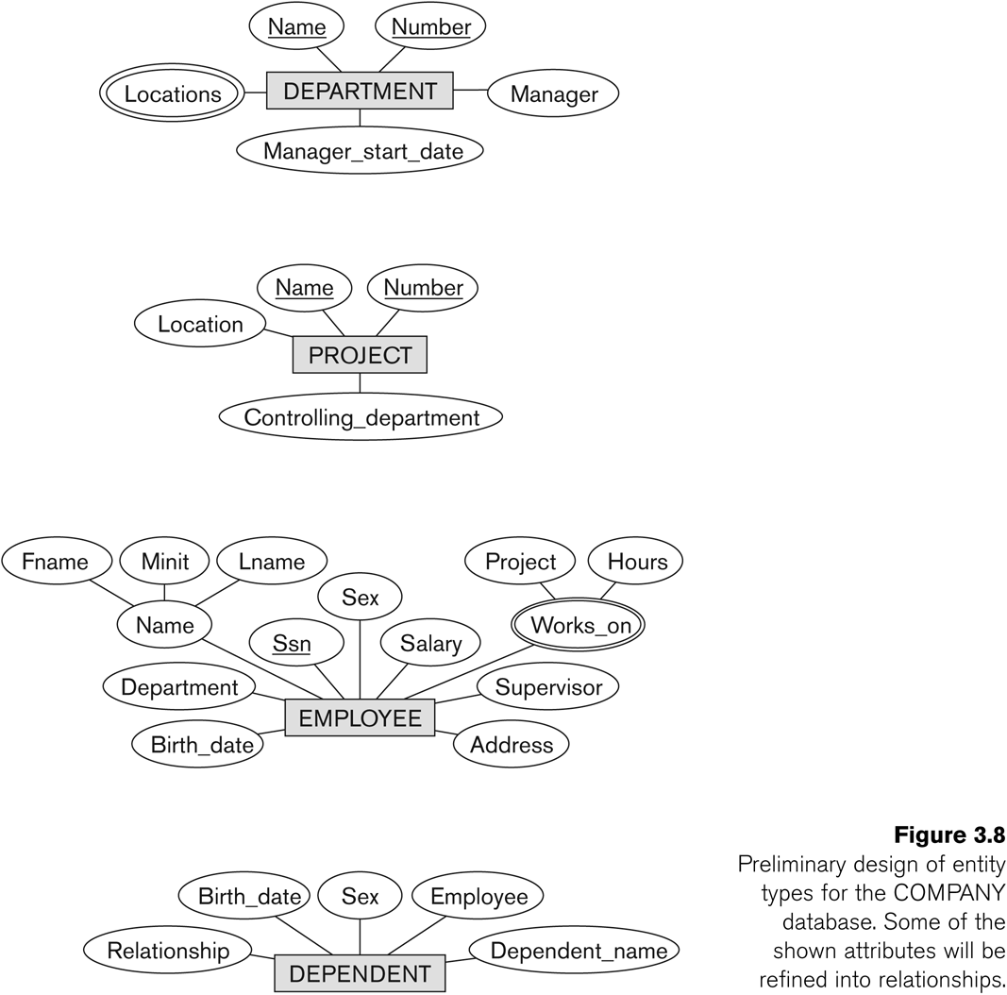
Initial Design of Entity Types: EMPLOYEE, DEPARTMENT, PROJECT, DEPENDENT

Slide 47
Sample Question
Consider the following tables:
Course (Course_id,Course_name)
Teacher (Teacher_id,Teacher_name)
Assigned_to (Teacher_id, Course_id)
a) How many tables will be created using the above scenario?
b) What will be the foreign key?
Notes:
https://dextutor.com/conversion-of-e-r-diagram-into-relational-model/

